Slide 1
Accenture internship
File created on: 7/15/2023 1:19:16 PM

Slide 2
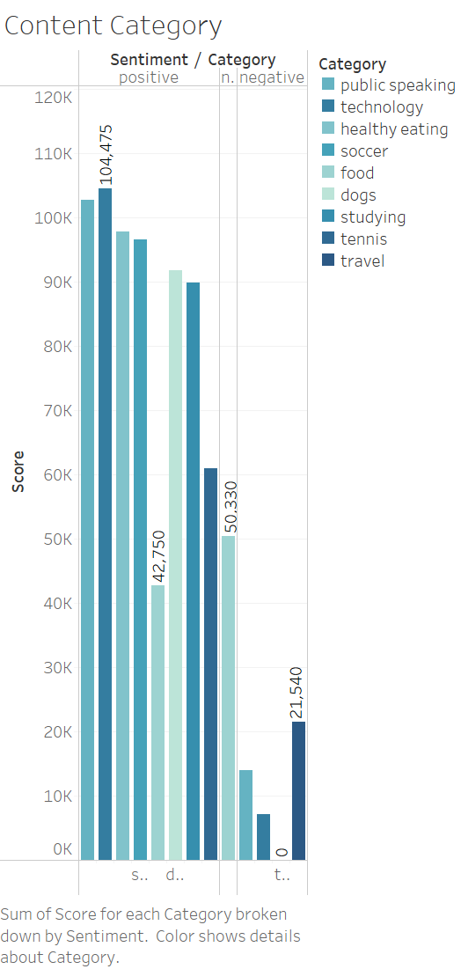

Slide 3
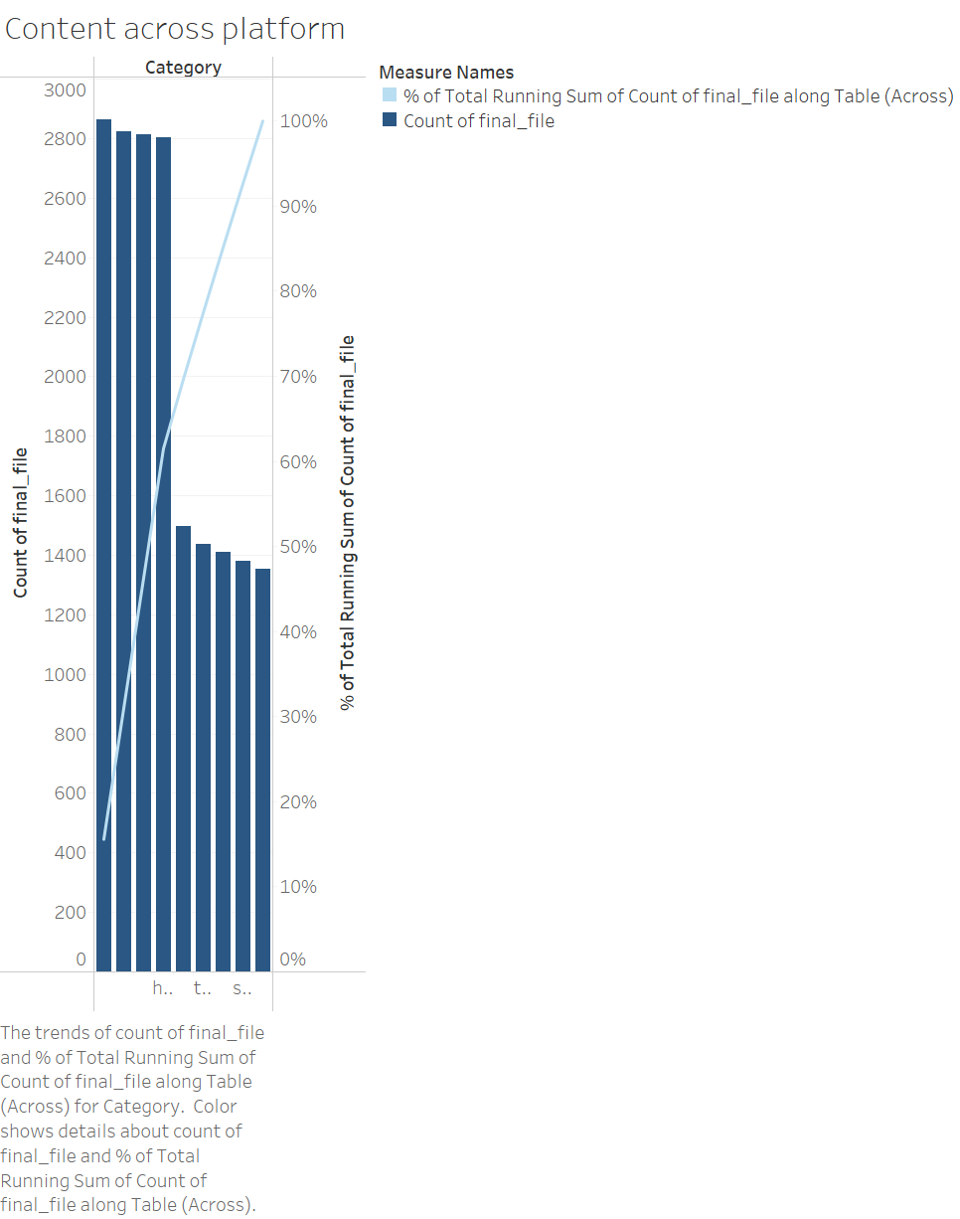

Slide 4
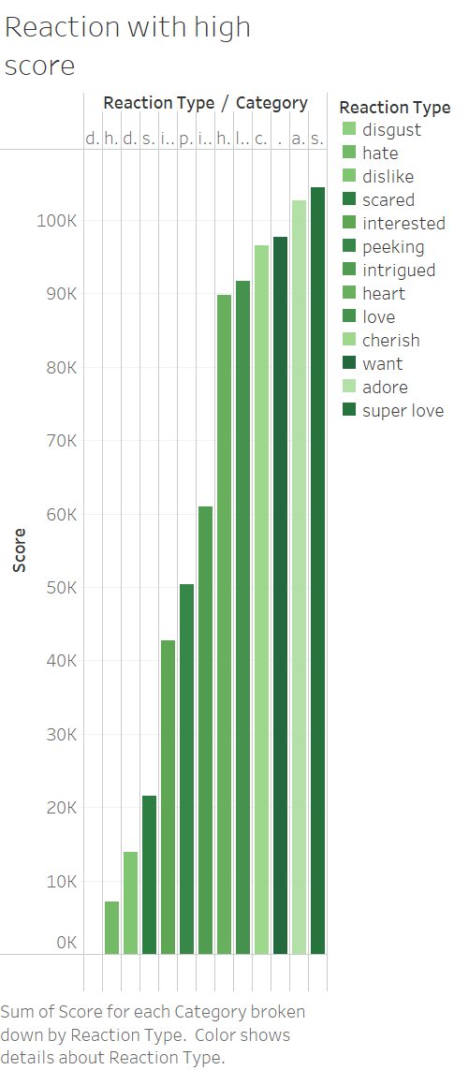

Slide 5
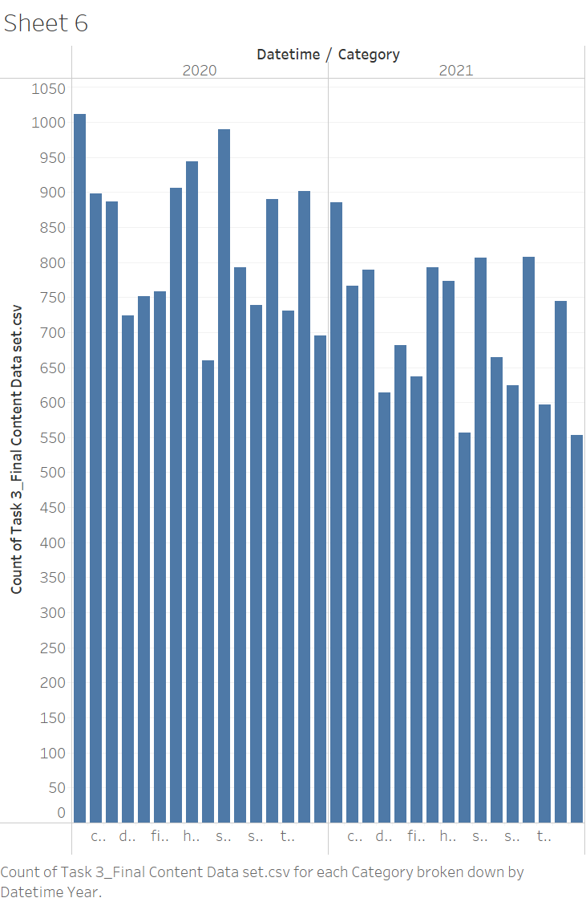

Slide 6
